Slide 1

Android 环境搭建
Hello world
@2017 Zhijun Hong
1

Slide 2
What 环境搭建
  Java 开发工具包(JDK)
    JDK8
  Android IDE
    Android Studio
    Eclipse IDE
@2017 Zhijun Hong

Slide 3
Hello World
  Hello World Application…
@2017 Zhijun Hong

Slide 4
Android 四大组件
  Android 四大组件
    Activities
    Services
    Broadcast Receivers
    Content Providers
@2017 Zhijun Hong

Slide 5
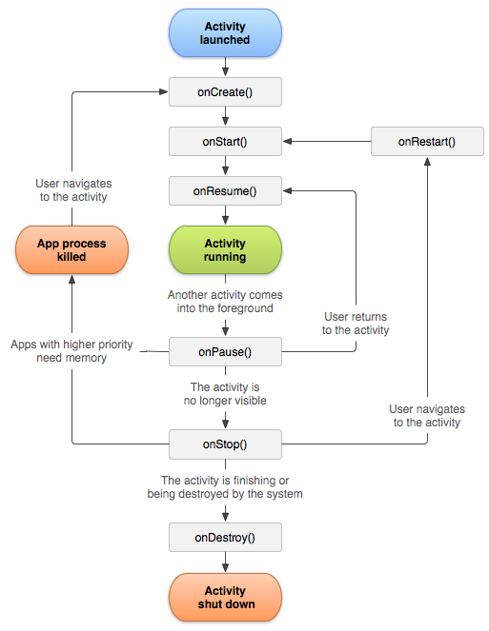
Android - Activities
Activity生命周期
@2017 Zhijun Hong

Slide 6
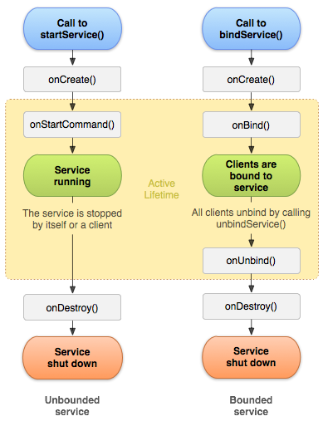
Android - Services
Services生命周期
@2011 Zhijun Hong

Slide 7
Android - Content Providers
  Broadcast Receivers Demo…
@2017 Zhijun Hong

Slide 8
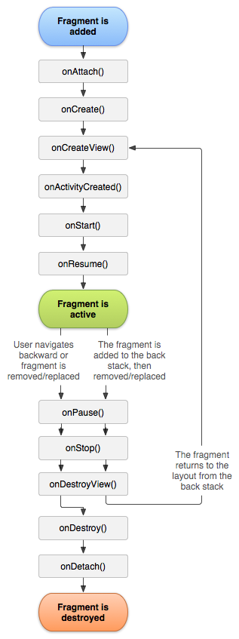
Android - 碎片(Fragment)
Fragment 生命周期
@2017 Zhijun Hong

